Slide 1
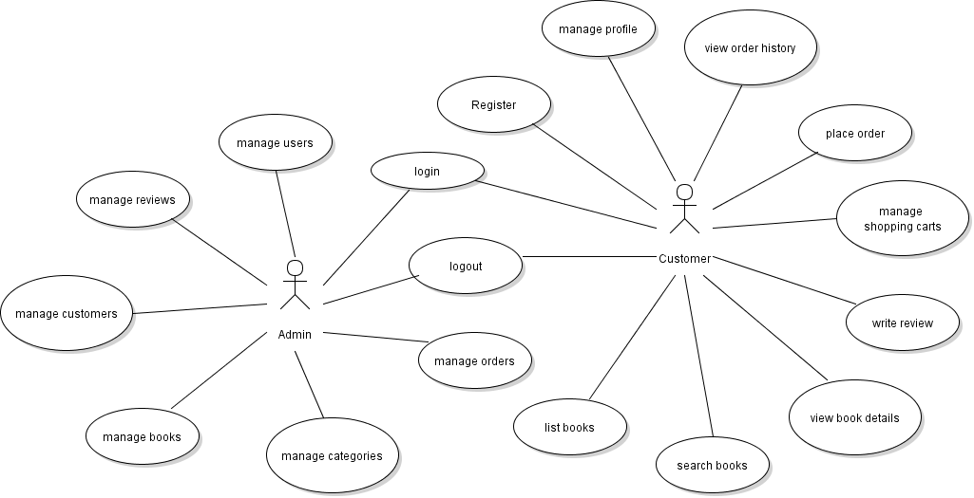
Implement Customer Registration Feature

Slide 2
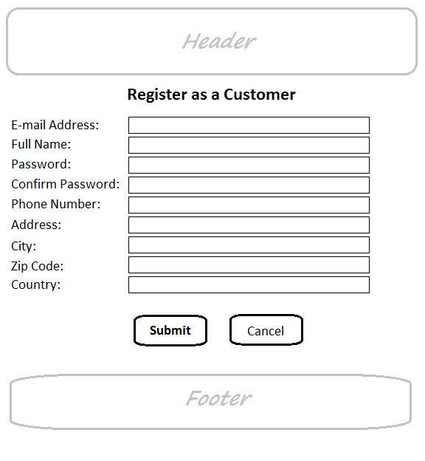
Customer Registration Form

Slide 3
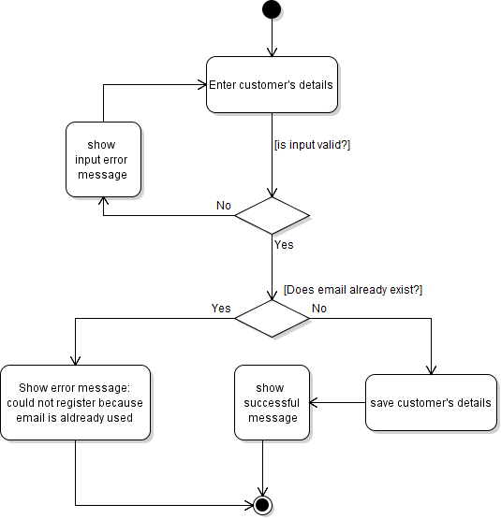
Activity Diagram: Register Customer

Slide 4
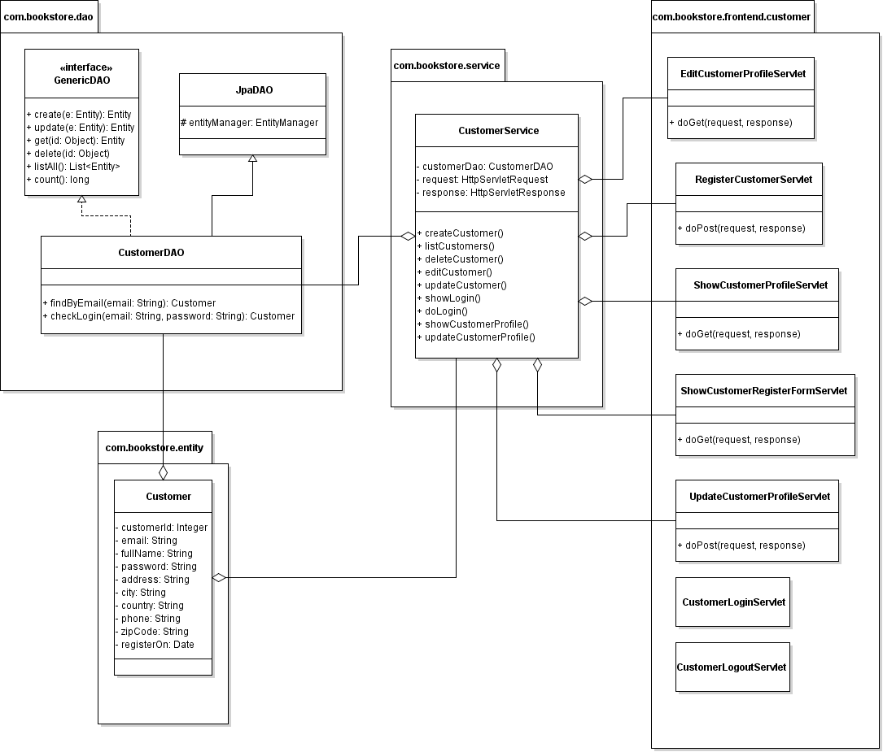
Class Diagram

Slide 5
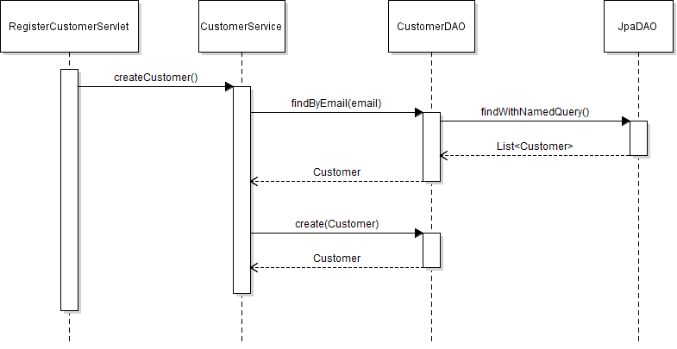
Sequence Diagram: Register Customer

Slide 6
Task List:
Create ShowCustomerRegisterFormServlet
Code Customer Registration Form
Create RegisterCustomerServlet
Update CustomerServices Class
Create Message Page (JSP)

